Slide 1

REAL ESTATE INVESTMENT COMPANY - PARTNERING SMEs

Slide 2
EXECUTIVE SUMMARY
Stéphane LIPP and his team of experienced professionals propose to create a high-yielding investment company dedicated to servicing its SME client-partners’ real estate requirements over the long term.
2. Objective: To develop a portfolio of real estate assets offering an exceptional risk/return profile of 10/10
Corporate governance: ► Leadership team in charge of operations
► Investment committee for oversight and approval
Opportunity for strategic investors: Majority shareholding
Total equity investment over 5 year period
► €267m
5. Exit in Year 5: Flotation with management taking a controlling interest
► Prospective IRR in Year 5: 25.5% (NAV €580m)

Slide 3
Conceptual framework
SME BENEFITS
- Real estate assets off balance sheet
- Long term relationship
- Contractual flexibility
- ▲cash▼debt
- ▼ RE = facilitates business transfer
- ▲ resources for core business
OBSERVATIONS
Focus on core business
= exit non-strategic assets
Economic changes
= new requirements
1. Stronger balance sheets
2. Diversify sources of finance
3. Prioritise growth (organic/external)
Increasing volume of business transfers
= sales facilitated by exit from non-core assets
- “Non-prime” real estate shunned by institutional investors
MARKET
- Scarcity of sources of finance
- Structural weakness of balance sheets
- Economic changes = SMEs need to adapt
- Few investors in « non-prime* »
RESULT
- Structural niche for long-term real estate partner for SMEs
Requirement to structure the SME real estate market
STRATEGIC INVESTORS BENEFITS
- New asset class
- Creation of Alpha
- IRR 25.5%
+
=
►
CAPSTONE
POST-IPO INVESTORS BENEFITS
- Alpha over underlying assets
- Risk/return profile 10/10
Long term leases (cash flow visibility)
- High rental yields
- Long term asset hold
- Non speculative/contra-cyclical
* Prime = standard construction, excellent location, mature market, AAA lease covenant

Slide 4
Innovative market approach
Standard approach
Capstone approach
Investors
CAPSTONE
seek
seeks
Investments regularly sold
Emphasis on quality of tenant
covenant for long- term hold
Prime real estate
SMEs with RE portfolio
AAA leases
- Large corporate tenants
Underlying real estate
- Long term leases
- Quality of location
- High rental yields

Slide 5
Sources of value creation
Creation of Managerial Value
1- Quality of management : asset selection and active management of the portfolio
2- Development of regional teams : local knowledge base
3- Management shareholders : interests aligned with strategic investors (vs.asset managers)
4- Creation of alpha : vs. underlying real estate
Creation of Financial Value
1- Development of a high-yield portfolio generating recurring LT revenues (similar profile to LT bonds)
2- Target risk/return profile 10/10
3- Construction of a diversified portfolio (cap rate compression)
4- Flotation (liquidity + debt reduction)
Creation of Real Estate Value
1- Risk reduction by:
● Number of investments (dispersion)
● Diversification of tenants by industry sector
● Diversification by asset type (office, retail, other…)
● Diversification by geographic location
2- Site conversion/development at end of lease term : Added value
3- Opportunistic sales : Capital gain

Slide 6
SUMMARY
  Expertise - L’équipe dirigeante
  Positioning of Capstone 10/10
  Strategic Approach
  Corporate Governance
  1. Management model
  2. Protection of investors’ interests
  Demonstration of risk/return profile 10/10
Business Plan
  1. Method & assumptions
  2. Rapid growth of revenue and cash flow
  3. Prospects for investors
Deal Pipeline
Appendices
  Expertise – Leadership Team

Slide 7
EXPERTISE – LEADERSHIP TEAM
Stéphane LIPP, age 37
Managing Director ► Project Promoter
CV
MD
Capstone Properties – France
Since 2009
Investor in corporate real estate
DIRECTOR OF INVESTMENT
DTZ Jean Thouard – France
2008
COUNTRY DIRECTOR
Wal*Mart – UK
2006 - 2008
Director Benelux – 2007/2008 ; Director CEE – 2006
Logistics real estate development
REAL ESTATE DIRECTOR
Financière Norbert Dentressangle – France
2004 - 2006
Creation of private equity real estate investment fund
- management of €350m asset portfolio
- development (100,000m² / pa)
CONSULTANT
CB Richard Ellis – France
1999 - 2004
PROPRIETOR
Sole trader – UK
1998 - 1999
Residential project management/renovation
EDUCATION
MBA Corporate Finance – 1995 - 1998
- European Business School, 1998, London ,UK
- Fordham University, 1995 - 1997, New York, USA
Ecole Supérieure de Commerce, 1993 - 1994
ESCRA-ISCAM
CNAM (Conservatoire National des Arts et Métiers)
- European Commercial Law, 1995
- French Commercial Law, 1993
Expertise

Slide 8
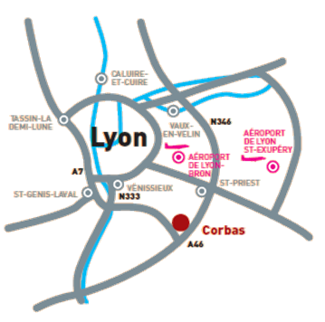
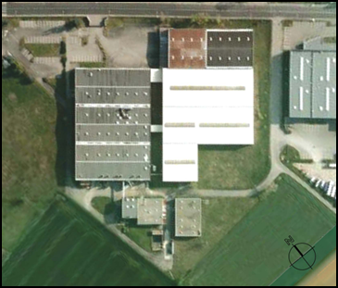
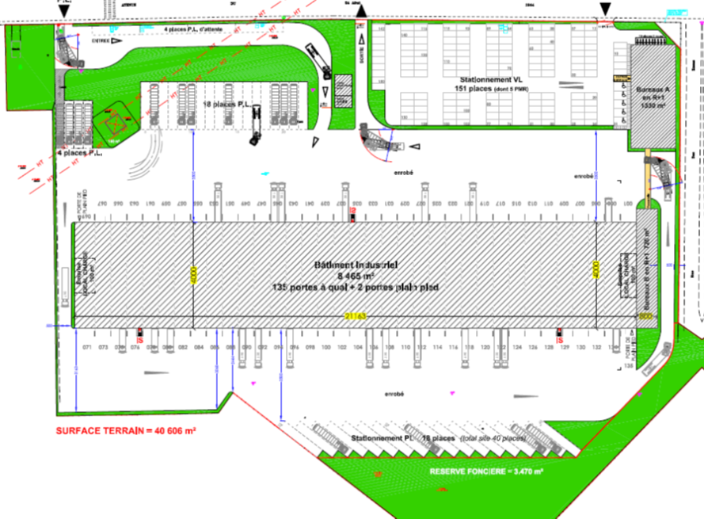
Corbas – entrepreneurial credentials
Ownership : S. Lipp (100% indirectly)
Acquisition November 2008
Location : Corbas (Lyon) - 3 junctions to A43 and Lyon East bypass at 400m
Area : 40 506 m² (11 acres) of land for conversion
Future cross dock warehouse: 11 000 m² approx
Acquisition price : €4.3m
Personal investment : €680k
Bank funding : €3.9m
Total investment : €12.5m
Projected annual gross rent : €1.1m
Projected net rental yield : 8.82%
Transfer of ownership to Capstone : Q1 2011
Expertise

Slide 9
A Leadership Team organised around the major management disciplines
Martin Prechner, age 60 (British) - joins Capstone Jan 2011
Director Corporate Finance & Asset Management
Ex FD Europe/Emerging Markets, real estate subsidiary of Wal*Mart
Finance
- Accounting & tax
- Funding & treasury
- Forecasting & budgeting
- Financial analysis & reporting
- Asset management
Legal
- Structuring
- Standard contracts
- Insurance
- Deal due diligence
Commercial
- Business development
- Deal sourcing
- Property management
- Leadership regional BU
- Tenant relations
Director of Finance and Tax, age 35 *
Currently FD of a major financial holding company
Balanced team
Key competencies
Diversity of backgrounds and experiences
Age mix
Bi-cultural
Complementary temperaments
Leadership
Chief Operating Officer, age 50 *
Currently Real Estate Director of a major industrial group
Legal Director/Corporate Counsel, age 35 *
Currently Legal Director of an industrial holding co.
Expertise
* 3 identities kept confidential at this stage

Slide 10
SUMMARY
  Expertise – Leadership Team
  Positioning of Capstone 10/10
  Strategic Approach
  Corporate Governance
  1. Management model
  2. Protection of investors’ interests
  Demonstration of risk/return profile 10/10
Business Plan
  1. Method & assumptions
  2. Rapid growth of revenue and cash flow
  3. Prospects for investors
Deal Pipeline
Appendices
  Positioning of Capstone 10/10

Slide 11
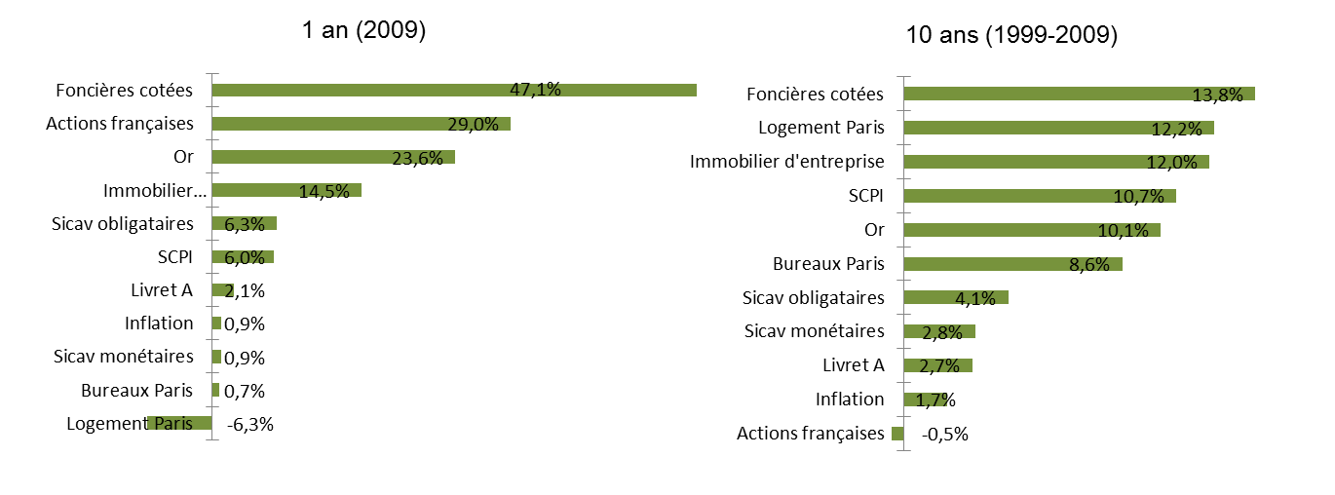
Comparison of investment returns by IRR
(Source IEIF)
Positioning of Capstone 10/10
NB: Revenue structure of quoted RE funds: recurring (rental) + exceptional (sale of assets).
► Average asset holding period: 4 to 6 years
► Gross rental yield: 5% - 7% (recurring revenues)
► Total 10 yr return = 13% ► recurring + leverage (average 20/80) + asset sales (cyclical = volatility)

Slide 12
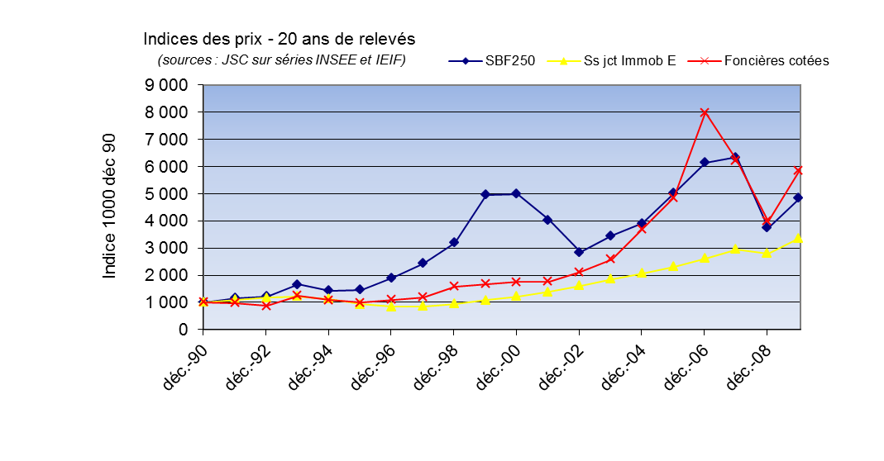
Market prices (income reinvested)
Positioning of Capstone 10/10
Risks/returns
Residential
real estate
Corporate
real estate
Quoted
Over 20 years
Bonds
Equities
REITS
Annual returns
5.1%
11.5%
3.5%
7.1%
12.7%
Risk = volatility
2.0%
24.5%
8.6%
10.2%
26.2%
Sharpe ratio
1.03
0.35
0.06
0.40
0.37

Slide 13
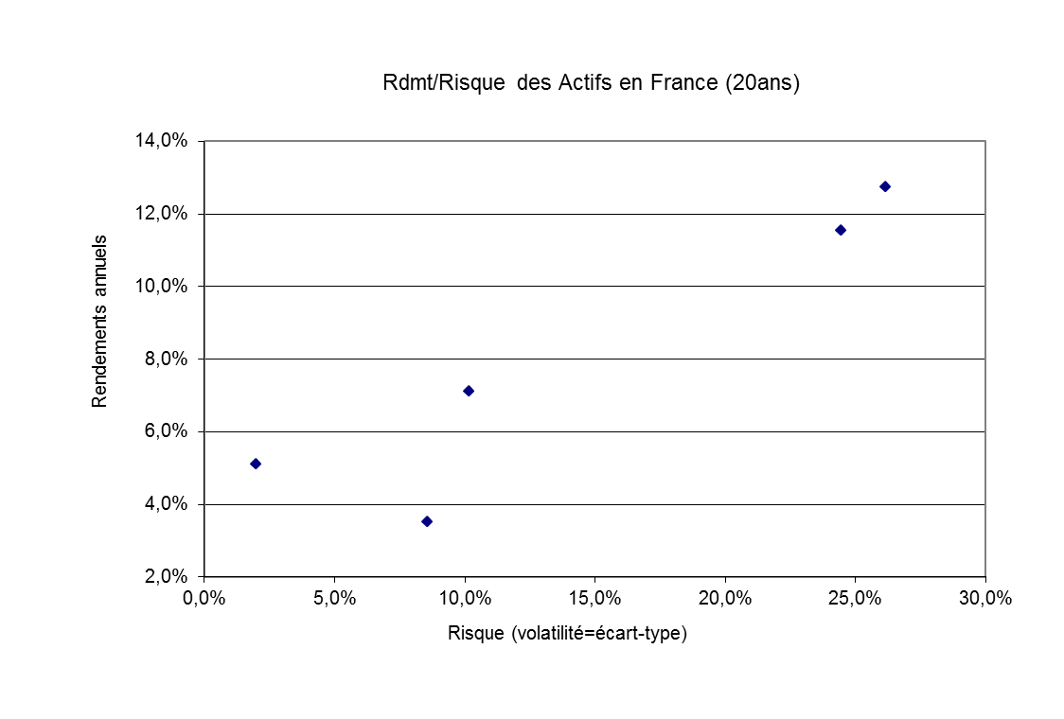
Positioning of Capstone
Quoted RE investment funds
Capstone
10/10
SBF 250
♦
Creation of Alpha
3% over underlying RE
Commercial RE
Positioning of Capstone 10/10
Bonds
Residential RE
Reduction in volatility of 16%

Slide 14
SUMMARY
  Expertise – Leadership Team
  Positioning of Capstone 10/10
  Strategic approach
  Corporate Governance
  1. Management model
  2. Protection of investors’ interests
  Demonstration of risk/return profile10/10
Business Plan
  1. Method & assumptions
  2. Rapid growth of revenue and cash flow
  3. Prospects for investors
Deal Pipeline
Appendices
  Strategic Approach

Slide 15
Concept: ► Investment in real estate assets of SMEs
By sale & leaseback of assets directly from SMEs (75%)
By acquisition of portfolios with SME tenants
By development of pre-let bespoke solutions
By site conversion at the end of the lease term
► Create a diversified high-yielding portfolio with:
High cash flow visibility (long leases)
Robust risk/return profile
► Long term holding of assets
► Progressive debt reduction
► No speculative activity
Objective: Generate stable, recurring, constantly increasing, long term revenues
Strategic approach

Slide 16
Targets: - « Non-prime » assets ► off the radar of institutional investors
- Initial gross rental yield : range of 8% - 13%
- Diversification by sector/asset type
- Diversification by geographic location
- Freehold title
- Absence of heavy pollution / complex planning requirements
- Purchase existing buildings or reconfigure to optimise operating efficiency
- France, Belgium (similar lease structures)
Methods : - Direct approach to SMEs (vs. real estate market)
- Creation of regional Business Units:
1. Local relationships/knowledge of local economic drivers
2. Recruitment through banking and advisor networks
- Partnerships (small business federations, chartered accountants, business disposal specialists…)
► Unique positioning (in Europe and USA)
► Response to a structural economic need
► Counter-cyclical portfolio
Strategic approach

Slide 17
SUMMARY
  Expertise – Leadership Team
  Positioning of Capstone 10/10
  Strategic Approach
  Corporate administration
  1. Management model
  2. Protection of investors’ interests
  Demonstration of risk/return profile 10/10
Business Plan
  1. Method & assumptions
  2. Rapid growth of revenue and cash flow
  3. Prospects for investors
Deal Pipeline
Appendices
  Corporate Governance

Slide 18

1. MANAGEMENT MODEL
A – Investment criteria
Our judgement of the key fundamentals for an acquisition
1- Geographic location
- Ability to re-let the site
- Ability to convert site to other uses at end of lease term
NB: The majority of target assets will be situated in dense urban areas ► land element will often be undervalued in relation to sale price
2- Financial stability of tenant
- Capacity of tenant to absorb rent payments without endangering the long term stability of his business
3- Asset Value vs Sale Price
- Asset value must be significantly higher than sale price
- Immediate gross rental yield > 8%
4- Debt/asset
► = f (lease term, location, asset type, volatility)
Corporate governance

Slide 19
B – Decentralisation of local knowledge = proximity to clients and markets
Management
Investors
(owners)
CAPSTONE
Commercial
Investment
Direct/indirect business development & deal flow
+ management of tenant relations.
Regional organisation in Business Units (BU)
(local knowledge).
Long term investment fund.
1 investment = 1 company.
Bank debt located at operating subsidiary level.
Corporate governance

Slide 20
C – Lean operating structure based on technology
Centralised management/decision making
IT tools : - Asset management software - Taliance
- Accounting software - Cégid (interface with Taliance)
- Server and back up off site - IBM (cloud computing)
- Linked to management software
- Overview of commercial activity
Leadership Team
- 5/6 people (specialist & hands on) *
- High value-added competencies
- Central overhead cost tightly controlled (salaries, office rent, IT)
Regional BU 1
- 1 director from banking background = awareness of local economic drivers
- No delegation of decision making to BU
- BU housed in premises let to tenants (zero rent cost)
Regional BU 3
Regional BU 2
Objective-oriented information
Intranet multi-access
Corporate governance
Decentralisation of local knowledge = teams close to clients and markets
Strategic investors : financial data and analysis in real time
* Commitment of all Leadership Team members to join at launch of the company

Slide 21
D – Revenue breakdown
Investment - Recurring revenues (> 90% = intrinsic stability of turnover)
- Rent + indexation during 1st lease term
- Revalued rent after conversion
- Services to tenants
Investment - Exceptional revenues:
- Opportunistic sales
- Improvement/extension works for tenants (management fee)
Regional BU - Fees of 2% of investment for all acquisitions by the investment company
- Services to SMEs
- BU responsible for their P&L and for commisions paid to 3rd party brokers
Corporate governance

Slide 22
E – Management fundamentals
Investment criteria: - Gross yield = > 8.00% net of acq. costs (average in BP = 10.35%)
- Lease term = Target 10 years (no break)
► except multi-tenanted assets (▼ void risk)
- Risk = No predominant rent revenue or asset value (5-10%)
Diversification by number of units and asset type
Geographic dispersion
- Asset hold = Very long term (> 10 ans)
- End of lease = Re-letting or conversion
Financial criteria: - SPVs = 1 investment = 1 company
- SPV shareholding = >95% for tax consolidation (target100%)
- Bank debt = Located at SPV level (non-recourse)
- Leverage (LTC*) = Average 50% equity / 50% debt (* Loan to cost)
- Debt reduction = Progressive
- Security = Mortgage
- Treasury = Centralised cash pooling
Corporate governance

Slide 23
F – Strategic allocation of the portfolio
Asset Classes of Corporate RE
Retail
Shopping
Centres
Office
Greater Paris
Office
ex Paris
Logistics
warehousing
Cross dock
logistics
Light
industrial
Hotels
Bespoke
buildings
Returns
Risk
Characteristics:
Typical tenants
Brands
Brands
Large groups
SME/large groups
SME
Chain or Luxury
SME
(majority)
Yields below 8%
Yes
Yes
Yes
Yes
Yes
Specific factors
“”Boxes” in
Retail parks
Customer
catchment area
Multi-tenant
Multi-tenant
Location
Location
< 4 000 m²
Location
Customer
requirements
(Business park)
Quality of mgt.
Depends on size
Approvals required
Yes
Yes
Yes
Depends on activity
Institutional investors
Yes
Yes
Yes
Yes if prime
Yes if
standard prime
Yes if
standard prime
Yes if park is
standard prime
Yes if prime
CAPSTONE
Yes
No
No
Yes
No
Yes
Yes
Yes
Yes
Freehold,
Low yields,
Opportunistic.
Vulnerability to
Location
Very high yields,
Inclusion/
exclusion
factors
location,
Level of
institutional
market
location,
changes in
Flexibility
quality of mgt,
alignment of
tenant/investor
requirements
capacity for
investment
multi-tenant
capability
approvals
High visibility
(multi-use)
capacity for
Corporate governance
conversion
(ICPE)
conversion
(tenant lock-in)
Target
portfolio
10%
-
-
23%
-
15%
25%
5%
22%
NB :
2/3
of French SMEs own their real estate (vs. 1/3 in USA)

Slide 24
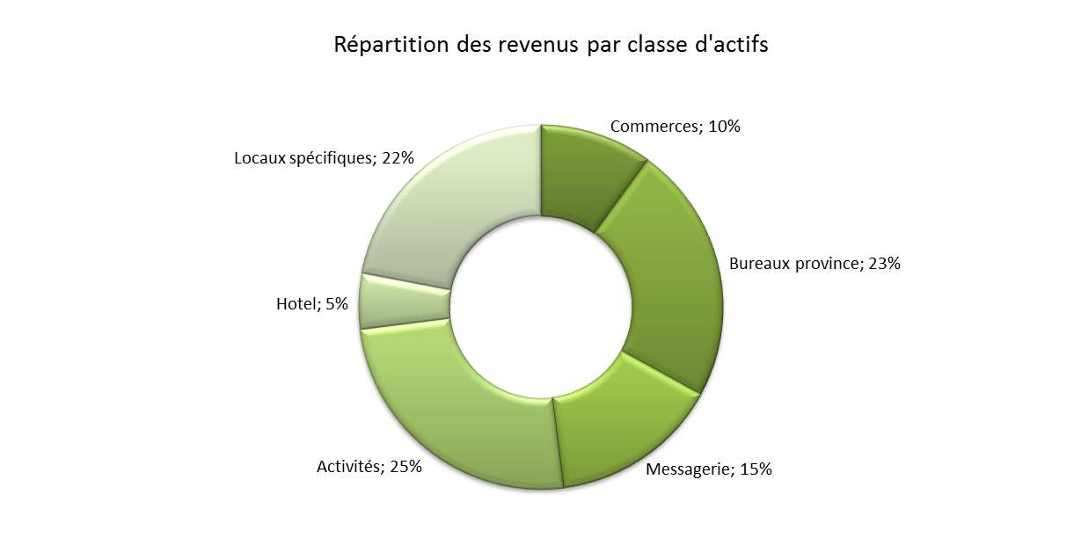
Definition of specific buildings:
- bespoke operational buildings
(e.g. automobile concessions)
- laboratories
- car parks
Corporate governance

Slide 25
2. PROTECTION OF INVESTORS’ INTERESTS
The governance of the investment company (SAS) will be structured around 3 cornerstones:
Leadership Team ► Manages the business, generates deal flow, proposes and executes the strategy
► Regulated by internal policies/guidelines
----------------------------------------------------------------------------------------------------------------------------------------------------------------------------------------
Investment Committee ► Investment approval > €2m (process to be established)
► Ensures compliance with business strategy
► Composition : Leadership Team (2) + 3 members designated by shareholders
► Voting by simple majority
----------------------------------------------------------------------------------------------------------------------------------------------------------------------------------------
Board of Directors ► Represents interests of investors (business owners)
► Voting by qualified majority (65%)
Responsibilities : shareholder pact, approves new shareholders and capital increases, nominates 3 members of investment committee, nominates auditors, manages IPO.
Corporate governance

Slide 26
Leadership Team
Operational management
Board of Directors
Represents interests
of shareholders
Investment Committee
Oversight & approval
3 complementary committees
Precise definitions of the scope and authority of each
► Value added : Concentration of scope on areas of expertise
► Investor security : - Presence of investment committee and board of directors
- No conflict of interest : management shareholders + mgt contract
► Efficiency : Reactivity inherent in light, decentralised structures
Corporate governance

Slide 27
Operating procedures: 1- Investment < €2m : delegation of approval to LT
► Pre-established, simple and pragmatic criteria
2 - Investment > €2m : approval by Investment Committee
► Clear approval process (information/vote/timing)
3 - Investment > €20m : approval by Board of Directors
Reporting timetable:
AGM
Results and prospects
Auditors report
Bi-annual meetings
Full activity report
Summarised quarterly reports
Sent to investors
Summarised quarterly reports
Sent to investors
Quarter 1
Quarter 2
Quarter 3
Quarter 4
Corporate governance
Permanent real time intranet access for investors
Financial/portfolio information
Rent summaries, portfolio allocation, void periods
Asset base

Slide 28
SUMMARY
  Expertise – Leadership Team
  Positioning of Capstone 10/10
  Strategic Approach
  Corporate Governance
  1. Management model
  2. Protection of investors’ interests
  Demonstration of risk/return ratio 10/10
Business Plan
  1. Method & assumptions
  2. Rapid growth of revenue and cash flow
  3. Prospects for investors
Deal Pipeline
Appendices
  Demonstration of risk/return profile 10/10

Slide 29
► Objective = 10/10
1. REDUCTION OF RISK to 10%
- Reduction of leverage
- Optimised diversification :
► Above 40 lines = asymptote of risk
- Efficient allocation of the portfolio
2 parameters
2. CREATION OF ALPHA to target 10% return
- Stock picking ► Territorial coverage
► Anticipation (management) of voids
► Quality of leadership team/experience
- Market timing ► Long lease terms = eliminates cycles
- Negotiation ► Lack of competition in non-prime market
Demonstration of risk/return profile 10/10

Slide 30
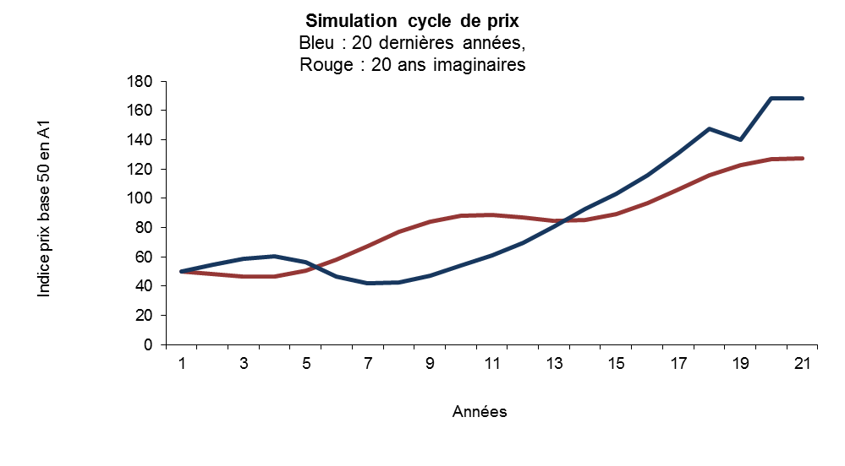
A - Testing and establishment of parameters
Parameters tested : - Leverage (20/80 vs. 50/50)
- Lease terms (9 years vs. 12 years)
- Pricing cycle of underlying assets (1990-2010 vs. counter-cyclical model)
2. Parameters applied to : - REITS
3. Results : - Return and risk for the investor
C1 = Cycle 1, actual data of last 20 years
Demonstration of risk/return profile 10/10
C2 = Cycle 2, model
C1
C2
Return
7%
5%
Risk
10%
6%

Slide 31
B - Reduction of risk by lower leverage
Standard investment in commercial RE = average leverage 20/80
Capstone = average leverage 50/50
Comparison of results :
Cycle 1
- last 20 years
Cycle 2
- model
Leverage
80%
Underlying
RE
Capstone
Quoted
REITs
Equities
Leverage
80%
Underlying
RE
Capstone
Annual returns
6.70%
13%
12%
11%
Annual returns
5%
13%
Volatility
10.00%
15%
26%
24%
Volatility
6%
16%
Sharpe
0.27
0.60
0.31
0.29
Sharpe
0.15
0.57
Demonstration of risk/return profile 10/10
Cycle 1
- last 20 years
Cycle 2
- model
Leverage
Underlying
RE
Capstone
Quoted
Equities
Leverage
50%
Underlying
RE
Capstone
50%
REITs
Annual returns
6.70%
10%
12%
11%
Annual returns
5%
10%
Volatility
10.00%
10%
26%
24%
Volatility
6%
11%
Sharpe
0.27
0.60
0.31
0.29
Sharpe
0.15
0.57

Slide 32
C - Innovative allocation of the Capstone portfolio
RE Funds
REITS
Capstone
Office
68%
36%
23%
Retail
17%
31%
10%
Industrial
7%
15%
62%*
Residential
7%
13%
0%
Hotels
1%
5%
5%
100%
100%
100%
Gross yield
7%
13%
10-11%
σ (risk)
10%
26%
10-11%
* Composition of Capstone "industrial":
Demonstration of risk/return profile 10/10
► light industrial, cross dock logistics, bespoke buildings…
Our data, assumptions and calculations show that the Capstone portfolio is situated on the efficient « risk/return » frontier of the 5 sub-classes of corporate real estate

Slide 33
SUMMARY
  Expertise – Leadership Team
  Positioning of Capstone 10/10
  Strategic Approach
  Corporate Governance
  1. Management model
  2. Protection of investors’ interests
  Demonstration of risk/return profile 10/10
Business Plan
  1. Method & assumptions
  2. Rapid growth of revenue and cash flow
  3. Prospects for investors
Deal Pipeline
Appendices
  Business Plan

Slide 34
1. METHOD & ASSUMPTIONS
1
Modelling of a complete BP
variables & assumptions
management accounts
cash flow & depreciation
forecast BS / P&L for 7 years
2
Activity assumptions / 5 years
114 investment scenarios
114 individual reasonable assumptions
3
Aggregation
aggregation of 114 separate balance sheets & P&Ls
5
Consolidation
consolidation of accounts
tax optimisation (fiscal consolidation)
reinvestment of free cash flow (cash pooling)
identification of capital requirement
4
Central management structure
modelling of an efficient structure
identification of central overheads
operating cost assumptions
6
Summary
consolidated financial statements
exit strategy
investor returns
Business plan

Slide 35
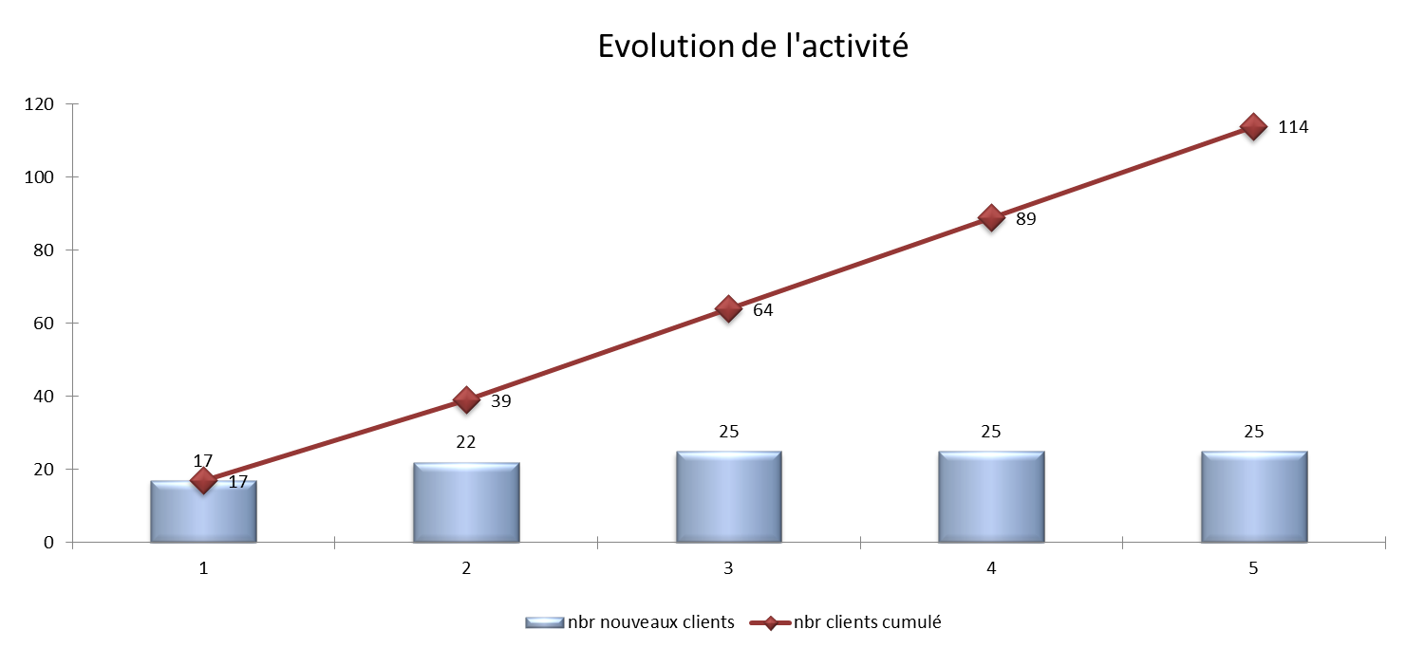
Projection of deal flow
Business plan
Y1
Y2
Y3
Y4
Y5
m² pa
109 600 m²
85 380 m²
109 300 m²
113 100 m²
117 750 m²
Cumulative m²
109 600 m²
194 980 m²
304 280 m²
417 380 m²
535 130 m²

Slide 36
Summary of Assumptions – Years 1 - 5
Number of investments: 114
Average lease length (no break): 9.5 years
Portfolio at cost – year 5: €665m ► = 535,130 m² (average investment = €5.8m)
Portfolio at valuation - year 5: €887m (before debt repayment)
Equity invested over period: €267m ► = 40.2% of total capex
Annual free cash-flow: 100% reinvested over the period
Average leverage: 50/50
Equity drawdown | Y1 | Y2 | Y3 | Y4 | Y5
Capital €m | 66.9 | 52.5 | 54.8 | 48.9 | 44.1
% of capex | 50.4% | 45.1% | 40.5% | 35.6% | 30.7%
Business plan
Average loan length: 15.8 ans
Average gross rental yield: 10.35%

Slide 37
2. RAPID GROWTH OF REVENUES AND CASH FLOWS
Profit & loss account
Y1
Y2
Y3
Y4
Y5
2011
2012
2013
2014
2015
Revenues
5.10
17.30
31.80
45.70
61.80
Increase pa
239%
84%
44%
35%
EBITA
1.89
13.16
26.25
38.56
53.38
Operating margin
37.1%
76.1%
82.5%
84.4%
86.4%
Depreciation
7.79
14.47
22.35
30.29
38.78
Operating profit
(5.90)
(1.31)
3.90
8.27
14.60
Finance costs
(1.80)
(4.88)
(8.03)
(11.14)
(14.54)
Net profit
(7.70)
(6.19)
(4.12)
(2.86)
0.06
ROI (EBITA/equity)
3.20%
12.48%
16.80%
19.06%
21.66%
Balance sheet
Y1
Y2
Y3
Y4
Y5
2011
2012
2013
2014
2015
Shareholders equity
59.21
10.52
156.26
202.35
246.52
Business plan
Bank debt
63.90
117.68
177.52
235.71
293.15
Fixed assets
125.17
227.08
339.90
446.38
550.09
Total assets
125.47
227.38
340.20
446.68
550.39

Slide 38
2. RAPID GROWTH OF REVENUES AND CASH FLOWS
Cash flow
Y1
Y2
Y3
Y4
Y5
2011
2012
2013
2014
2015
Operating cash flow
0.09
8.28
18.22
27.43
38.84
OCF/equity
0.16%
7.85%
11.66%
13.55%
15.76%
Share capital
66.92
52.50
54.86
48.95
44.11
Bank debt
63.90
53.78
59.84
58.19
57.44
Tenant deposits
2.35
1.82
2.24
2.20
2.10
133.26
116.38
135.16
136.77
142.49
Investments
(132.96)
(116.38)
(135.16)
(136.77)
(142.49)
Change in working capital
(0.30)
-
-
-
-
Free cash flow reinvested
0.02
6.12
13.20
19.69
27.36
Business plan
NB : Flotation costs excluded

Slide 39
3. PROSPECTS FOR INVESTORS
5 year objective: Stock market flotation
► option to apply for REIT status (see appendix)
Benchmark valuation methods:
Method | Application | Valuation €m | IRR
NAV* | Cap rate @ 8.0% - debt | 548 | 23.6%
DCF** | Op. cash flow/(8.2% - 3%) - debt | 612 | 27.4%
 | Range | 548 to 612
 | Median | 580*** | 25.5%
► Return on equity at exit €313m (117%)
*Prudent cap rate at 8.0%
**Op. cash flow in Y6 8.2% = discount rate of RE funds (TSR + β (stock market return-TSR)) = 4 + 0,7 (10 - 4)
TSR = risk free interest rate
3% = long term economic growth
***Valuation of recurring revenues only = exclusion of tenant services, opportunistic sales, internal commissions to BU, optimisation of tax consolidation… (potential upside)
Business plan

Slide 40
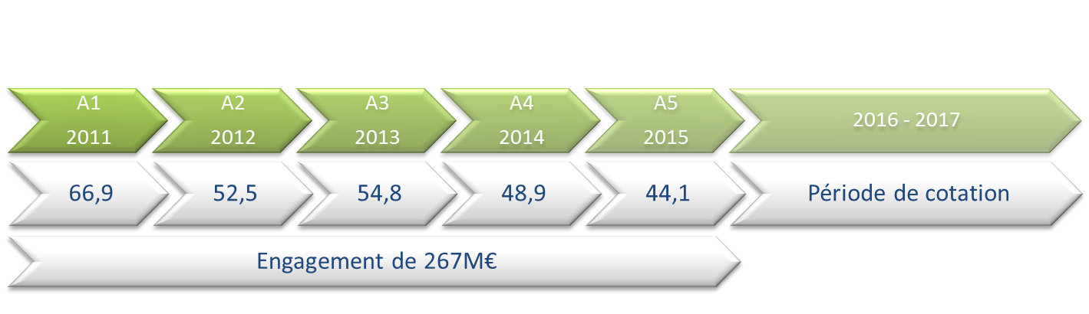
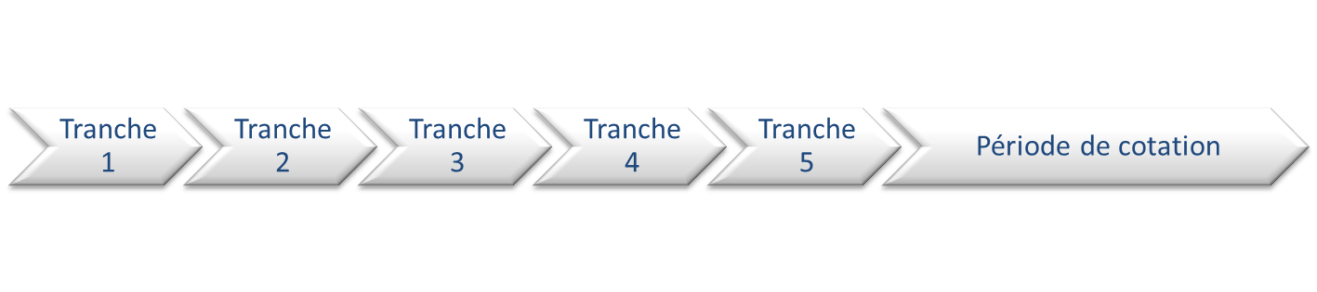
Equity drawdown
1. Capital calls in €m ►
2. Capital issued ►
Optimisation of flotation date according to market conditions
Strategic investors commitment €x
+ management contribution
Investor group 2 – commitment €x (1)
Investor group 3 – commitment €x
(1) If entry of new investors: valuation of shares @ NAV
Business plan
Pre-emption rights for previous investors
in following tranches (non-dilution)
3. Governance ►

Slide 41
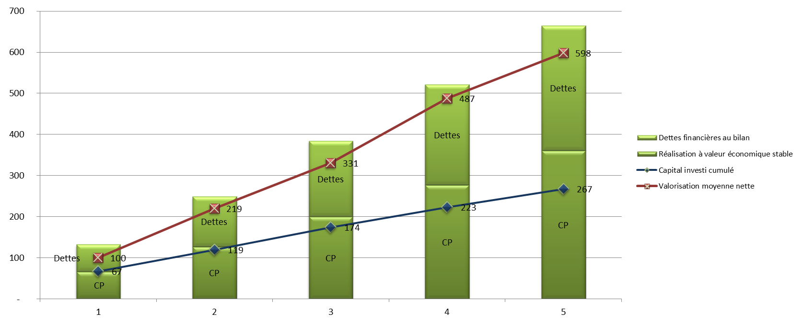
Growth analysis – capital requirement vs. portfolio valuation
€m
Y1
Y2
Y3
Y4
Y5
Average
Investment portfolio at cost
133
249
384
522
665
Bank debt
66
122
184
244
304
Net proceeds at stable economic value
66
127
200
277
361
Equity invested
67
119
174
223
267
Safety margin / equity invested
-
1
8
26
54
94
-1%
6%
15%
24%
35%
Business plan
Increase in equity invested
78%
46%
28%
20%
43%
Portfolio valuation (median)
100
219
331
487
598
Increase in portfolio valuation
119%
51%
47%
23%
60%
€1 invested = €x value created
1.50
1.84
1.90
2.18
2.24
1.93

Slide 42
Timeline - implementation of pipeline investments and leadership team recruitment
► Implementation of pipeline investments (Rives de Paris, St Priest)
- Park of 12 buildings
- Greater Paris
- 50 tenants
- €4.3m rent pa
- 11.7% rental yield
Timeline
Rives de Paris
2010
2011
Invest
Sept
Oct
Nov
Dec
Jan
Feb
Mar
Apr
May
Jun
Jul
Aug
Equity
Exclusivity agreement
Due diligence
LOI / Offer
Price adjustments
Exchange of contracts
Legal/financial structuring
Completion
€ 25m
Timeline
Saint-Priest
Sept
Oct
Nov
Dec
Jan
Feb
Mar
Apr
May
Jun
Jul
Aug
CP
- 55,000m² site
- Greater Lyon
- Commercial dev. project + SME park
PUV (ex parte contract)
Due diligence
Completion
€ 0.6m
► Leadership team recruitment
2010
2011
Payroll
cost pa
Monthly
cost
Gross
salary pa
Joining date
Sept
Oct
Nov
Dec
Jan
Feb
Mar
Apr
May
Jun
Jul
Aug
Sept
€k
€k
€k
S. Lipp
Operational Capstone
315
26.25
210
Business plan
M. Prechner
Operational Capstone
270
22.5
180
Legal Director
Notice period
270
22.5
180
Finance Director
Notice period
270
22.5
180
Property Director / COO
Notice period
270
22,5
180

Slide 43
Working capital requirement
Start up period
2010
2011
€k
Nov
Dec
Jan
Feb
Mar
Apr
May
Jun
Jul
Aug
Sept
Oct
Nov
Dec
Total
Payroll
48.8
48.8
48.8
71.3
93.8
116.3
116.3
116.3
116.3
116.3
116.3
116.3
1,125.0
Office rent
7.5
7.5
7.5
7.5
7.5
37.5
Server/back up (cloud)
0.7
0.7
0.7
0.7
0.7
0.7
4.2
Structural overheads
0
0
48.8
48.8
48.8
71.3
93.8
116.3
117.0
124.5
124.5
124.5
124.5
124.5
1,166.7
Telecommunications
0.3
0.3
0.3
0.3
0.3
0.3
0.3
0.3
0.3
0.3
0.3
0.3
3.6
Legal fees (structuring)
10.0
10.0
Bookkeeping/payroll.
0.2
0.2
0.2
0.2
0.2
0.2
0.2
0.2
0.2
0.2
0.2
0.2
2.4
Office consumables
0.2
0.3
0.2
0.3
1.0
Postage and printing
0.1
0.1
0.1
0.1
0.1
0.1
0.1
0.1
0.1
0.1
0.1
0.1
1.0
Travel and subsistence
0.7
0.5
0.7
0.5
0.7
0.5
0.7
0.5
0.7
0.5
0.7
0.5
7.2
Operating overheads
0
0
11.5
1.1
1.3
1.4
1.3
1.1
1.5
1.1
1.3
1.4
1.3
1.1
25.2
IT hardware/software
2.0
2.0
2.0
2.0
8.0
Portfolio mgt. system
10.0
15.0
30.0
25.0
80.0
Websites: internet+intranet
15.0
15.0
Business plan
Fixed assets
0
2.0
0
2.0
12.0
0
17.0
15.0
0
30.0
0
0
25.0
0
103.0
Grand total
0
2.0
60.2
51.8
62.0
72.6
112.0
132.3
118.4
155.5
125.7
125.8
150.7
125.5
1,294.9
Cash requirement
pre-revenue generation
493.1
Rental revenue Rives de Paris
Structure becomes self-financing

Slide 44
SUMMARY
  Expertise – Leadership Team
  Positioning of Capstone 10/10
  Strategic Approach
  Corporate Governance
  1. Management model
  2. Protection of investors’ interests
  Demonstration of risk/return profile 10/10
Business Plan
  1. Method & assumptions
  2. Rapid growth of revenue and cash flow
  3. Prospects for investors
Deal pipeline
Appendices
  Deal Pipeline

Slide 45
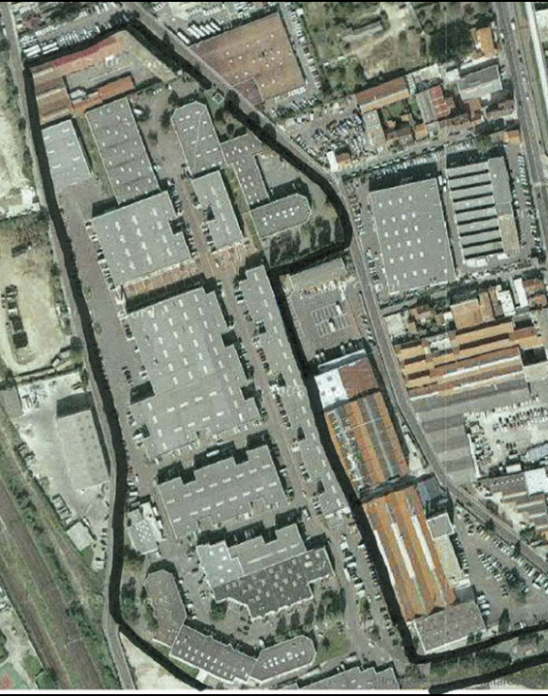
1- Rives de Paris – Enterprise Park of 12 tenanted buildings – Paris périphérique
Exclusive negotiation of acquisition ongoing
Signature of sale agreement for 47% of capital : 7/1/2011
Commitment for 60% of capital projected : mid February 2011
Location : Close to the Paris périphérique ring road, excellent access
Closed enterprise park : 12 buildings, total 43 000 m² built area
Tenants : 55 approx, none predominant
Rental void : 0%
Form of acquisition : Majority control of an SA company
Price of 100% acquisition: €45m approx
Initial gross rental yield: ≈ 10%
Projected completion : July 2011
Condition: Very good, construction 2002-2006 (80%)
Deal pipeline

Slide 46
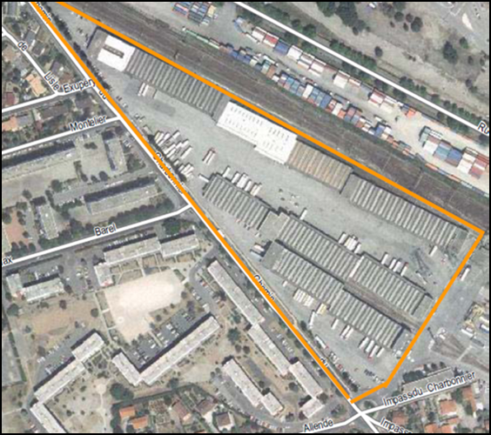
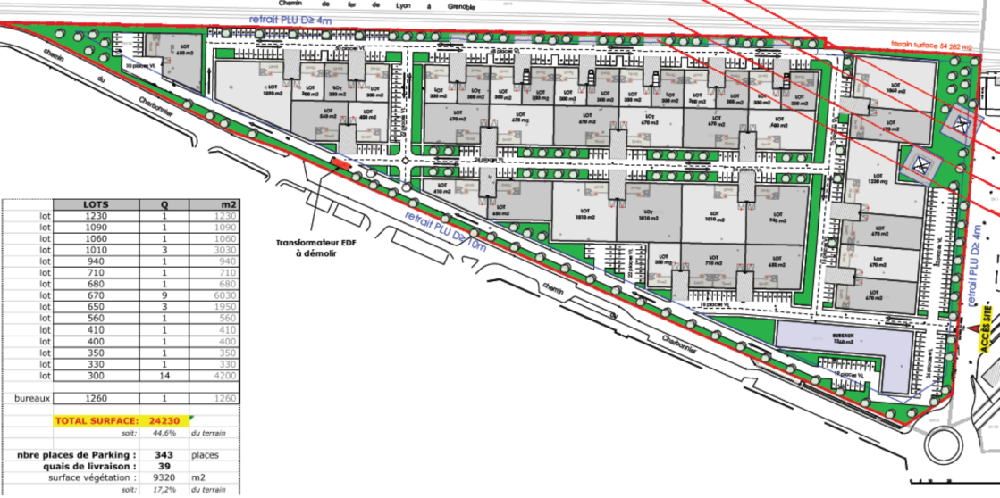
2- Development of an SME Enterprise Park – Saint-Priest (Lyon)
Ex parte contract (PUV) signed in December 2010
Completion: Q1 2011
Location : Saint-Priest (Lyon), 500m from new Lyon East bypass
Area : 55 000 m² (13 acres) land for construction
Future enterprise park: 24 230 m²
Projected tenants: 40
Initial investment : € 1.5m (March 2011)
Total investment : € 20.4m
Projected annual gross rent : € 2.1m
Projected net rental yield : 10.21%
Vendor : 4 corporate shareholders (SCI)
Deal pipeline

Slide 47
3 – Land for construction of a bespoke pre-let warehouse – Corbas (Lyon)
► Detail shown in Slide 8 (credentials)
Transfer of ownership from S. Lipp
Location : Corbas (3 junctions to A43 and Lyon East bypass at 400m)
Area : 40 506 m² land for construction
Future cross-dock warehouse: 11 000 m² approx
Acquisition price: €300k
Bank finance: €3.9m
Transfer of ownership : Q1 2011
Marketing : Negotiations ongoing with two potential tenants
Deal pipeline

Slide 48
Further deals under consideration and/or negotiation
Deal pipeline

Slide 49
SUMMARY
  Expertise – Leadership Team
  Positioning of Capstone 10/10
  Strategic Approach
  Corporate Governance
  1. Management model
  2. Protection of investors’ interests
  Demonstration of risk/return profile 10/10
Business Plan
  1. Method & assumptions
  2. Rapid growth of revenue and cash flow
  3. Prospects for investors
Deal Pipeline
Appendices
  Appendices

Slide 50
CORPORATE STRUCTURE AND MANAGEMENT CONTRACT - 1
S. LIPP
ISIS (manager)
employs Leadership Team
Shareholders pact
& internal policies
Management contract + BSA (1)
CAPSTONE (2)
Majority shareholders
Strategic investors
(owners)
100%
100%
Commercial co.
Investment co.
Contractual link
Capital link
(1) Bons de souscription d’actions (share warrants)
(2) Company to float in Year 5

Slide 51
CORPORATE STRUCTURE AND MANAGEMENT CONTRACT - 2
Companies
ISIS SAS Holding co. owned by management-shareholder
► Object : Control after flotation (pre-IPO = optimisation of valuation)
CAPSTONE SAS ► Investment holding co. to float in year 5
Majority owned by strategic investors
    Tax consolidator
    Capital contribution / Stéphane LIPP
    ► Initial valuation of Capstone shares
Total €15.1m – strong capital commitment (see next page)
    Contracts
Management contract : Carried interest based on strategic investors’ exit IRR
► Objective : Alignment of interests - strategic investors/management
► Security: Management intention to take controlling interest on exit
► Carry : Share warrants issued to ISIS

Slide 52
VALUATION OF STEPHANE LIPP CAPITAL CONTRIBUTION

Slide 53
SENSITIVITY ANALYSIS – EXIT VALUATION
Sensitivity IRR / DCF
Economic growth
2.50%
3.00%
3.50%
β
Discount rate
0.75
19.8 %
24.5%
29.5%
0.70
22.6%
27.4%
32.6%
0.65
25.4%
30.5%
36.0%
Sensitivity IRR / ANR
Capitalisation rate
7.50%
8.00%
8.50%
27.0%
23.6%
20.3%

Slide 54
RECRUITMENT PLAN
Y1
Y2
Y3
Y4
Y5
Leadership Team
5
5
Regional BU openings
Paris South
Lille
Marseille
N/A
N/A
Lyon
Paris West
Regional Directors
5
1
2
2
Business Developers
10
2
2
2
2
2
Total
20

Slide 55
OVERHEAD COSTS
Central costs of holding company
€m
Y1
Y2
Y3
Y4
Y5
Structural overheads
Salaries and related costs
1.65
2.06
2.40
2.69
2.89
IT & telecommunications
0.07
0.04
0.04
0.04
0.04
Office rent
0.09
0.09
0.10
0.10
0.10
Total
1.81
2.19
2.54
2.83
3.03
Operating overheads
Professional fees.
0.06
0.04
0.03
0.04
0.05
Utilities
0.03
0.04
0.05
0.06
0.07
Other office costs.
0.17
0.18
0.19
0.19
0.19
Travel & subsistence
0.11
0.16
0.20
0.24
0.27
Total
0.37
0.42
0.47
0.53
0.58
Depreciation
0.61
1.04
1.45
1.81
2.17
Total central costs
2.79
3.65
4.46
5.17
5.78

Slide 56
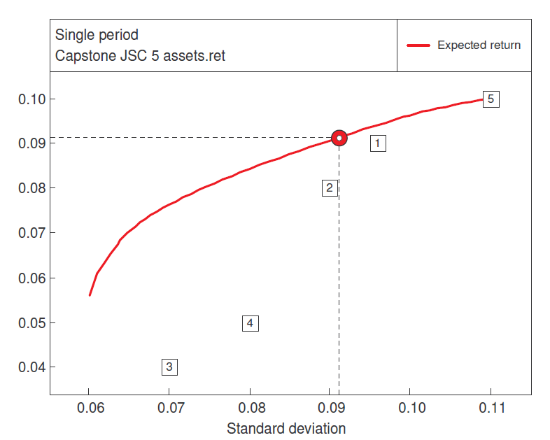
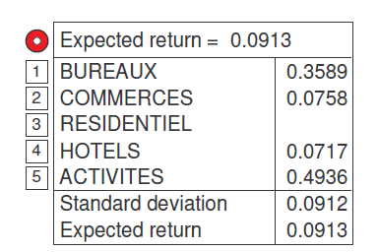
PORTFOLIO ALLOCATION

Slide 57
COMPETITION – CAPSTONE vs. LEASING
NB: Capstone = faster decision process

Slide 58
QUOTED INVESTMENT COMPANIES – REIT STATUS (SIIC)
Conditions :
Asset base : > €15m
Payment of exit tax in Y1 : = NAV x 20%
Majority holding : < 60%
Consequences:
Exemption from corporate tax : Income and capital gains
Compulsory distribution : - 85% of net income
- 50% of capital gains
- 100% of dividends from subs
Tax on vendors : CT on capital gain ≈ 19% for sale of buildings to a SIIC

Slide 59
THANK YOU FOR YOUR ATTENTION

